Slide 1


CORONA VIRUS ANALYSIS IN SQL
Data Analyst
Internship Mentorness
Presented by Nouhaila TYOUBI

Slide 2

INTRODUCTION:
Overview of the Project:
This research involves analyzing a dataset connected to the coronavirus pandemic. The goal is to use SQL and data analysis abilities to extract important insights and convey them effectively.
The collection offers thorough information on the virus's transmission, effect, and recovery across many regions and time periods.

Slide 3

DATA DESCRIPTION
A brief description of the dataset:
The collection contains records of CORONA VIRUS cases reported internationally, including location, time, and case status (confirmed, deaths, or recovered).

Slide 4
DATA DESCRIPTION
Explanation of the Columns:
Province: Geographic subdivision within a country/region.
Country/Region: Geographic entity where data is recorded.
Latitude: North-south position on Earth's surface.
Longitude: East-west position on Earth's surface.
Date: Recorded date of CORONA VIRUS data.
Confirmed: Number of diagnosed CORONA VIRUS cases.
Deaths: Number of CORONA VIRUS related deaths.
Recovered: Number of recovered CORONA VIRUS cases.

Slide 5

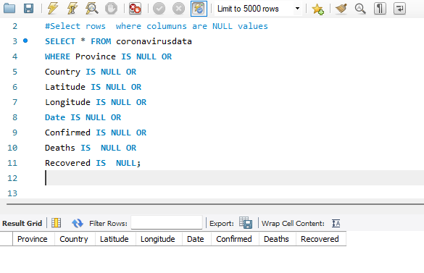
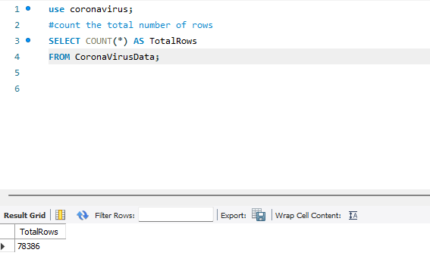
METHODOLOGY
the SQL Queries Used and Result

Slide 6
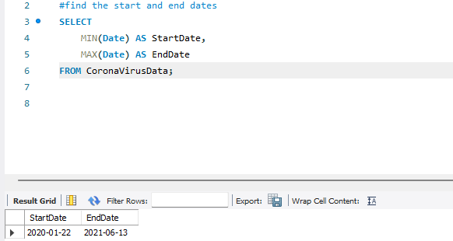
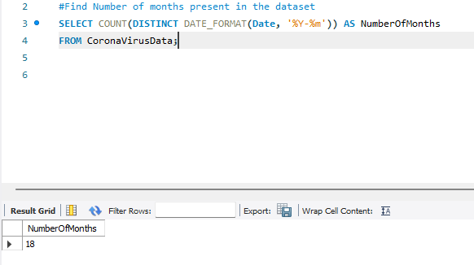

Slide 7
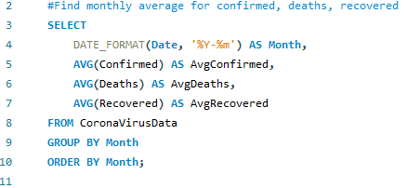
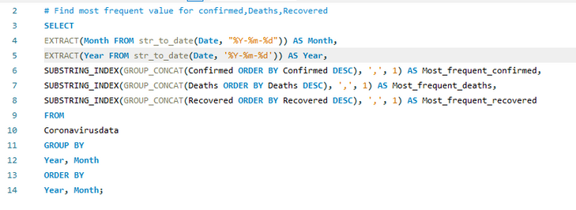
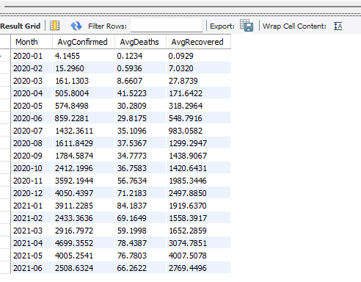
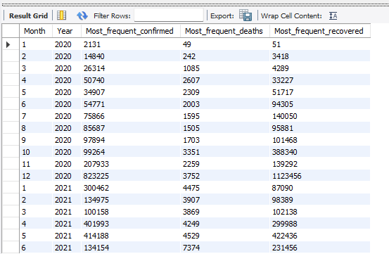

Slide 8
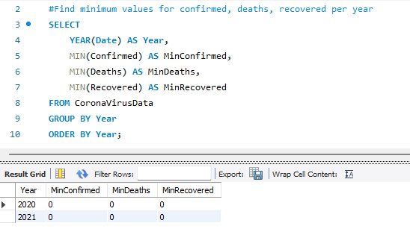
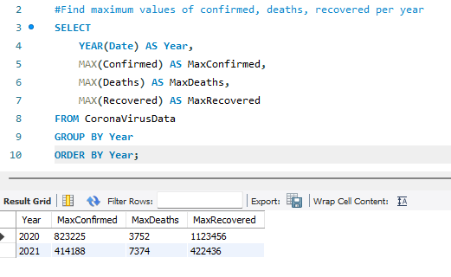

Slide 9
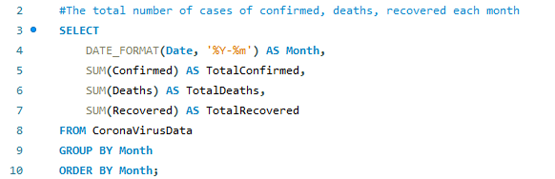
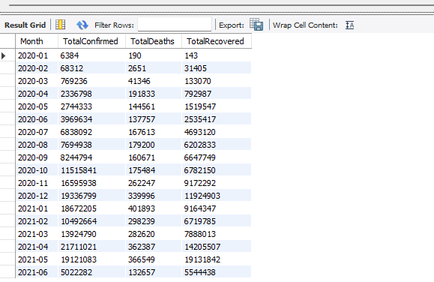
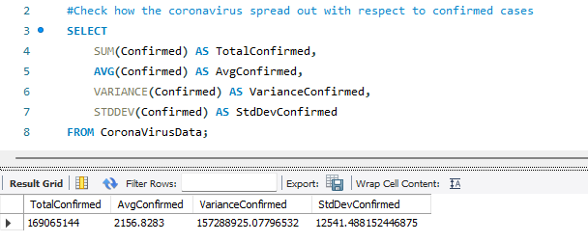

Slide 10
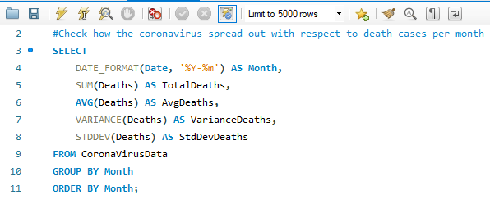
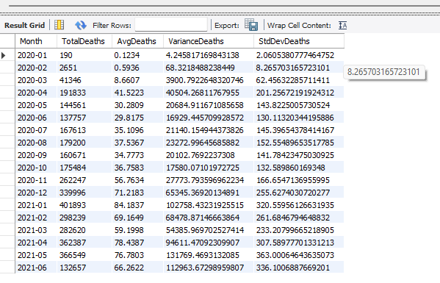

Slide 11
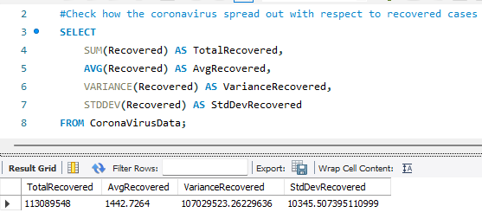
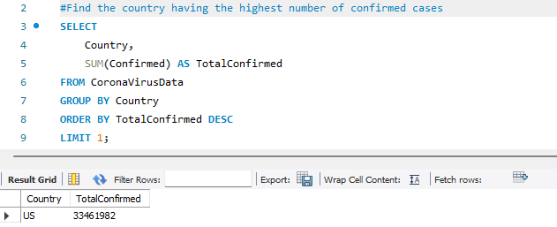

Slide 12
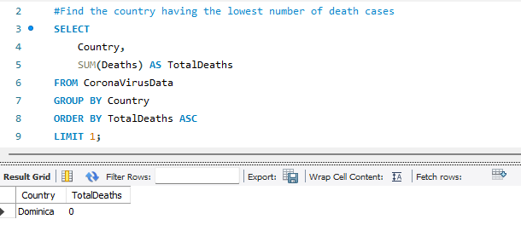
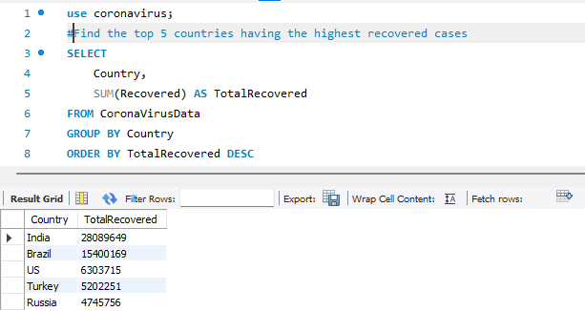

Slide 13
KEY TRENDS
The number of confirmed cases, deaths, and recoveries showed distinct waves, with big peaks and low points.
Some months had very high cases, showing major outbreaks. For example, April and December 2020 had many cases in all categories.
Both 2020 and 2021 had days with no reported cases. This could mean problems with data collection or actual days with no cases.
The highest daily cases went up from 2020 to 2021, showing the pandemic got worse.

Slide 14
KEY TRENDS
High Variability: Confirmed and recovered cases had high ups and downs, showing big daily changes.Deaths also changed a lot, but less than confirmed and recovered cases.
Monthly Fluctuations: Death cases had high ups and downs, especially during big outbreak months. This shows the inconsistency and unpredictability of death counts each month.
Leading Countries: India, Brazil, the US, Turkey, and Russia had the highest numbers of recoveries, showing big efforts in managing and recovering from the virus.
.

Slide 15
KEY TRENDS
The United States had the highest number of confirmed cases (33,461,982), showing it was the most affected country by infections.
High Total and Variability: The total confirmed cases were very high (169,065,144), with big daily changes. This shows the widespread and inconsistent nature of the pandemic.
High Recovery Rates: The total recovered cases were high (113,089,548), with big daily changes, showing effective treatment and recovery efforts.
.

Slide 16

THANK YOU!

